Slide 1
November 2023 release of Power BI apps on telemetry
Dynamics 365 Business Central

Slide 2
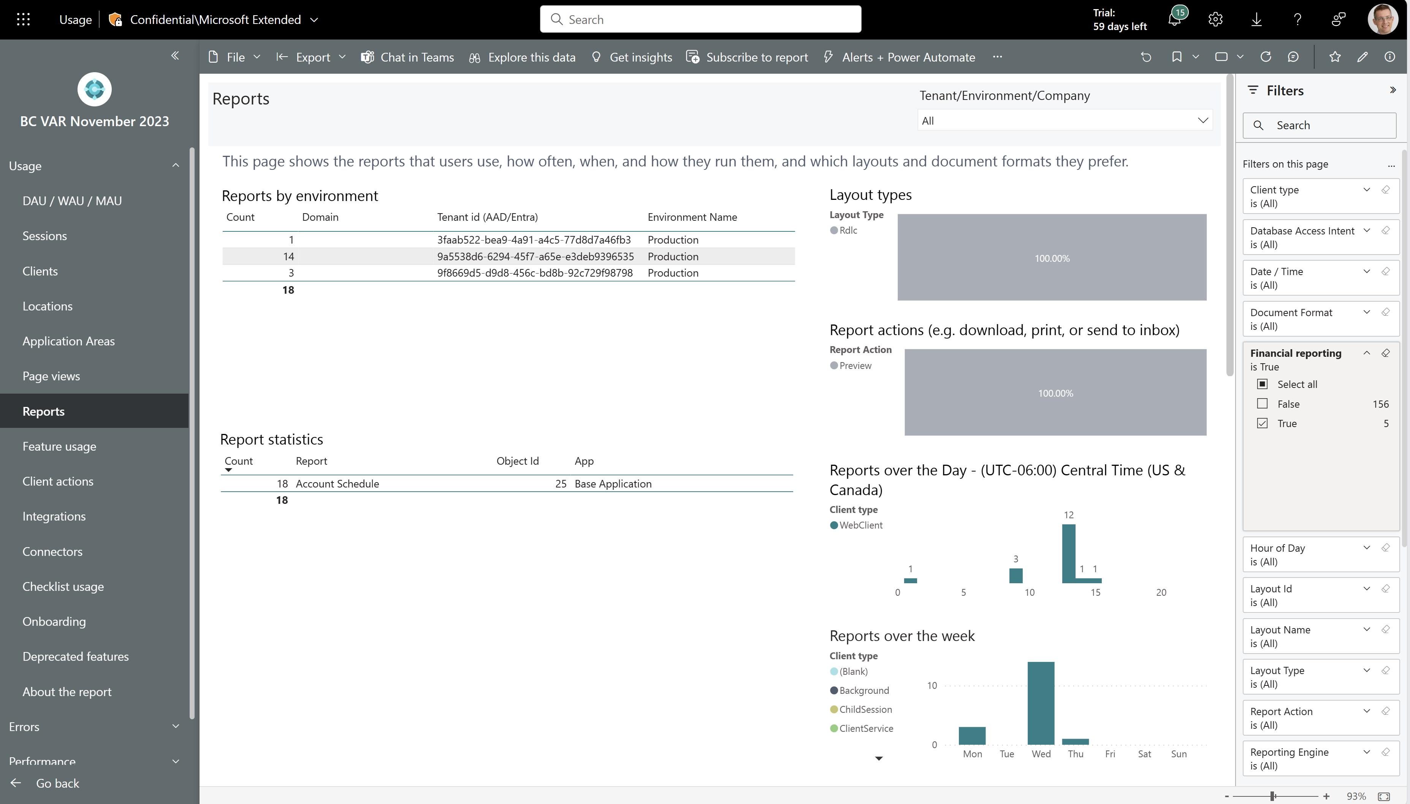
Monitor usage of the Financial Reporting feature
See usage of the Financial Reporting feature across all customers.

Slide 3
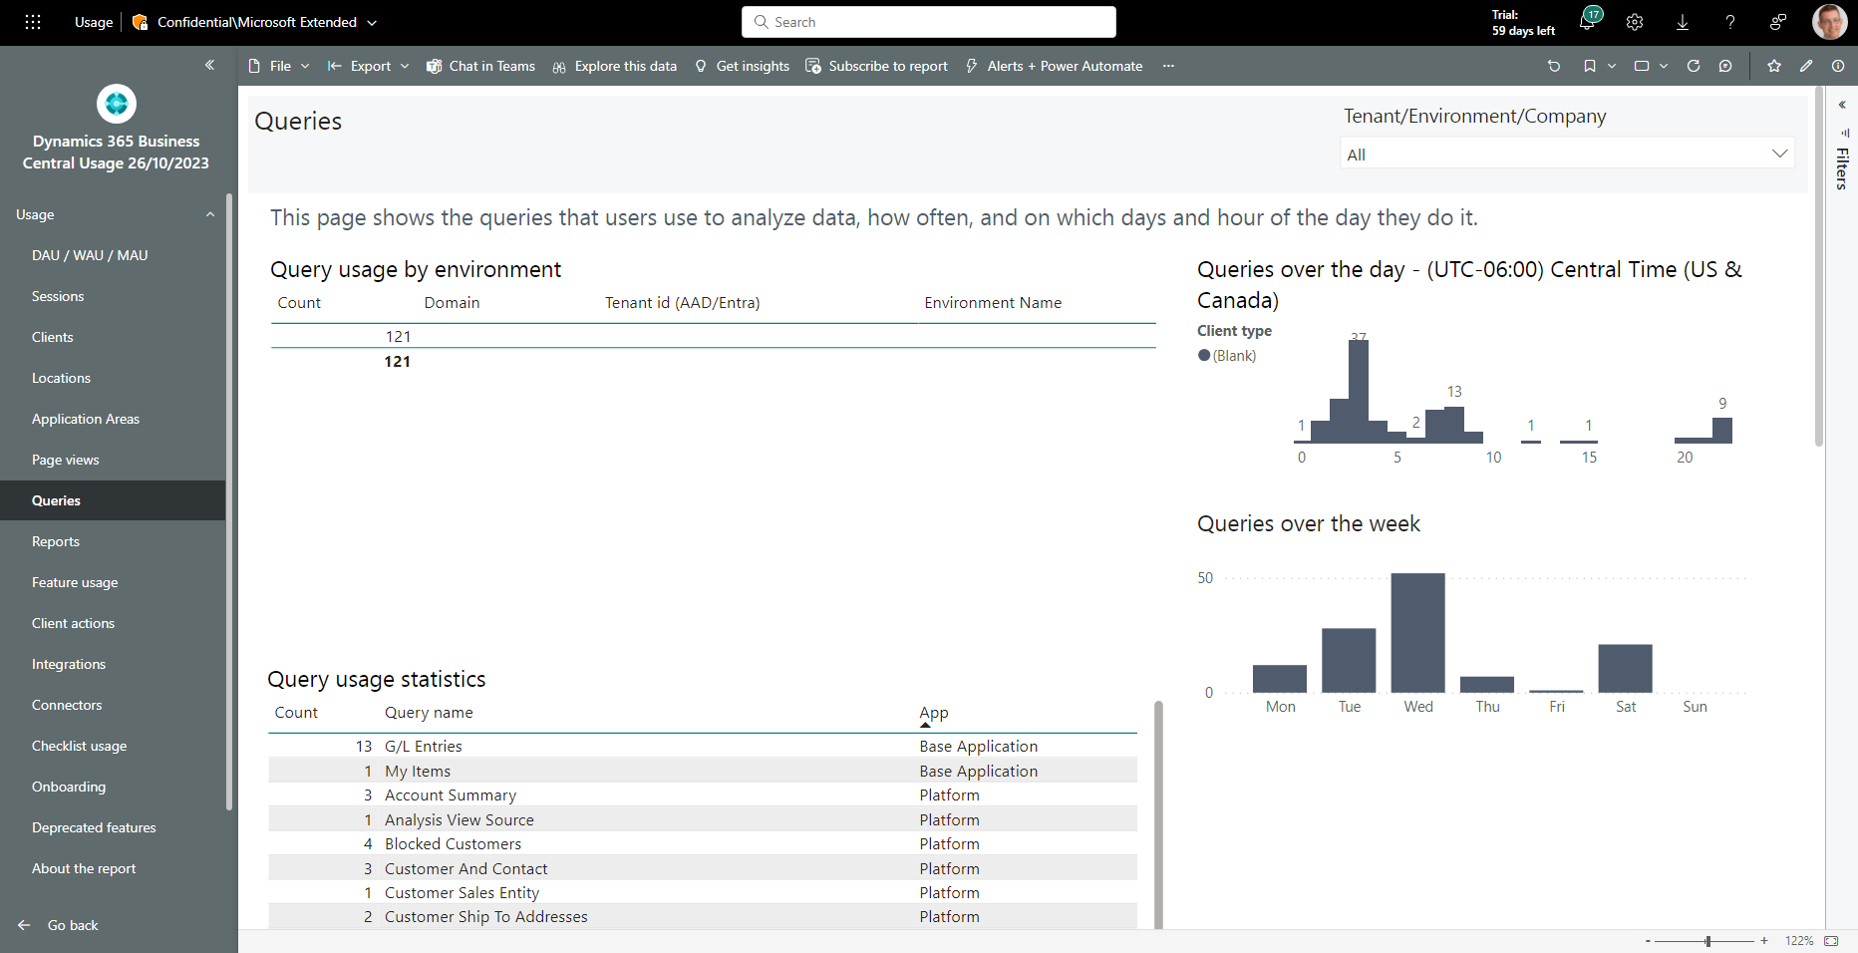
Monitor usage of queries (for data analysis)
See usage of queries (for data analysis) across all customers.

Slide 4
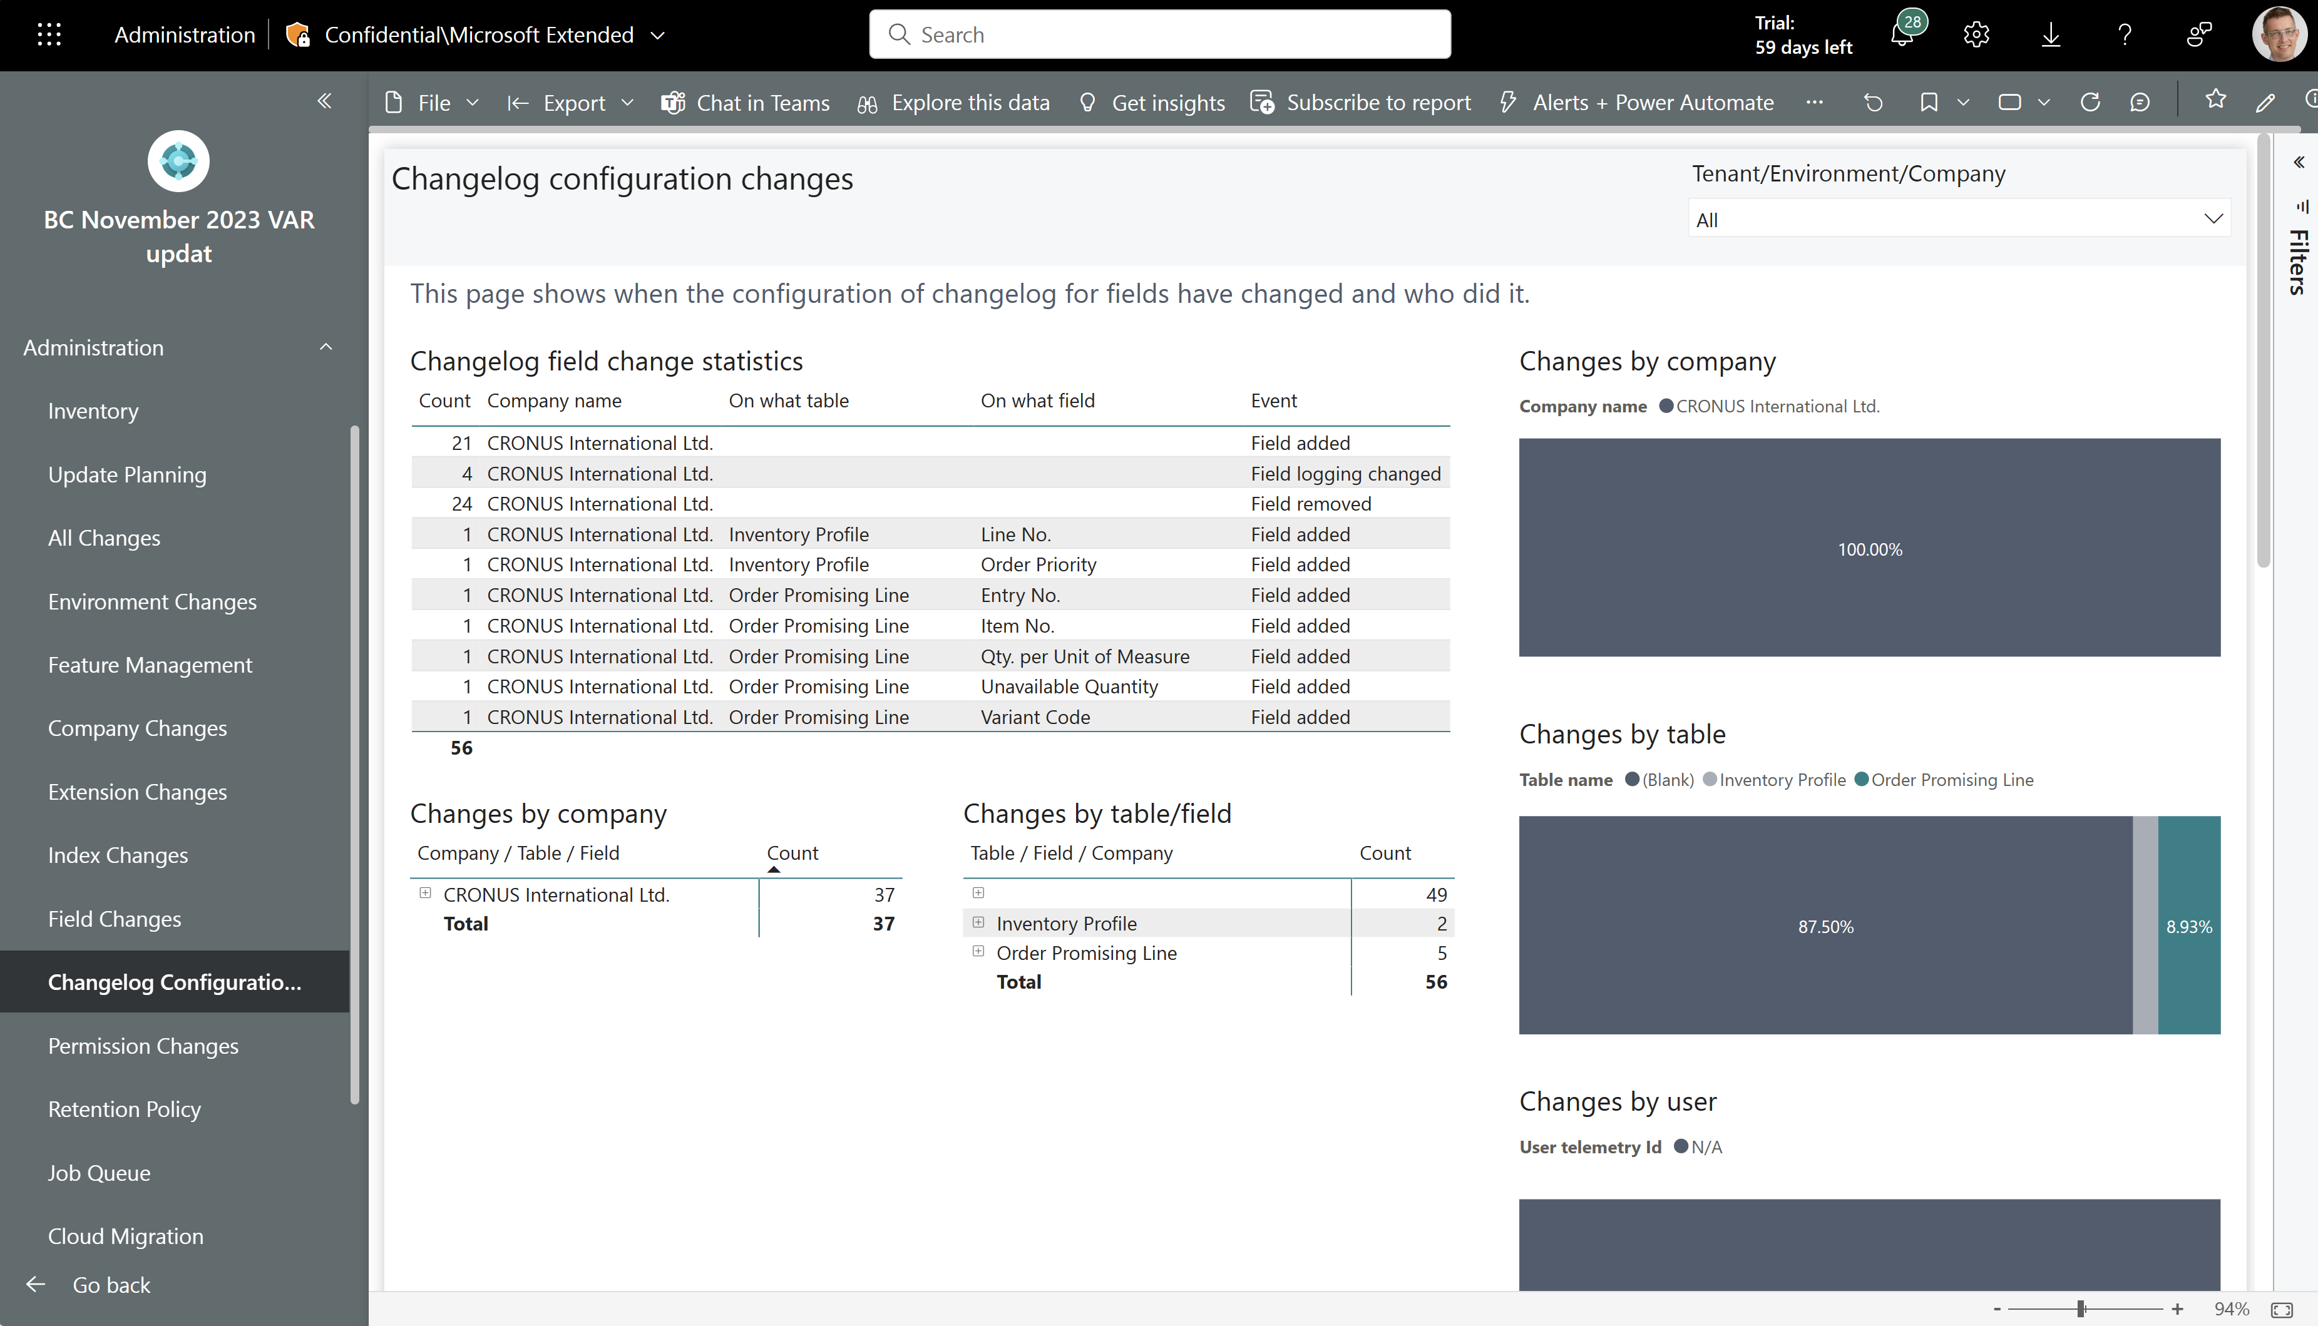
New administrator report: Change log configuration
See all changes to change log configurations that happened across all customers.

Slide 5
Get the apps from Appsource
For environment telemetry
https://aka.ms/bctelemetryreport
For app telemetry
https://aka.ms/bctelemetry-isv-app

Slide 6
TEMPLATE
See all changes to change log configurations that happened across all customers.

